Slide 1
Databricks Deployment Workflow
Vikash Verma

Slide 2
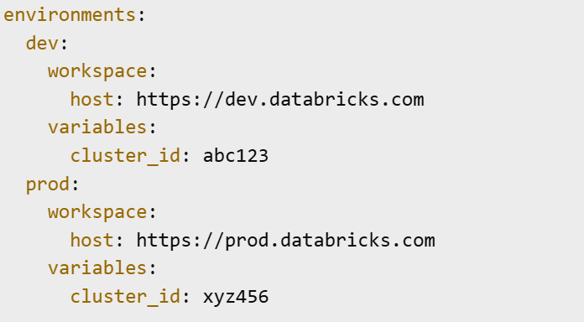
bundle.yml env Blocks
Purpose: Define environment-specific configurations in a single bundle.yml file.
Structure
Best Practice: Use environment variables for secrets and sensitive data.

Slide 3
Deploy vs Sync
Deploy:
Pushes notebooks, jobs, and configurations to Databricks.
Typically used in CI/CD pipelines.
Sync:
Keeps local and remote files in sync during development.
Good for iterative coding.

Slide 4
Secret Scopes
Purpose: Securely store and access secrets in Databricks.
Types:
Databricks-backed: Managed within Databricks.
Azure Key Vault-backed: Integrates with Azure Key Vault.
Usage:

Slide 5

Validate & Tag
Validation:
Run linting, unit tests, and pipeline checks before deployment.
Ensure bundle.yml syntax correctness.
Tagging:
Add version tags in Git after successful validation

Slide 6
Rollback
Purpose: Revert to a known stable version after a failed deployment.
Methods:
Redeploy a previous Git tag.
Restore from Databricks job run history or notebook revisions.

Slide 7
Promote to Test
Process:
Deploy validated code from dev to test environment.
Run integration tests.
Verify job performance and data outputs.
Tip: Use separate clusters and DBFS paths per environment.

Slide 8
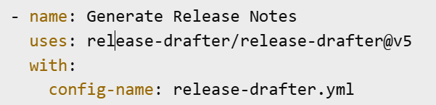
Auto Release Notes
Purpose: Automatically generate changelogs for each release.
Implementation:
Use GitHub Action or Azure DevOps task to parse commit messages.
Generate a markdown file with features, fixes, and changes.

